Slide 1
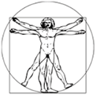
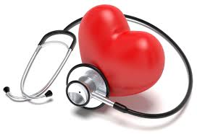
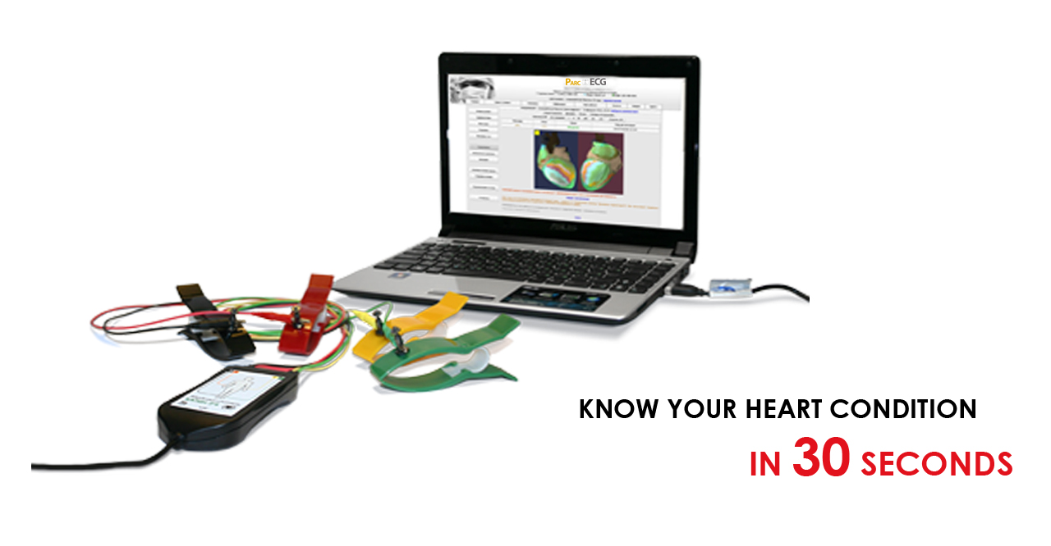
Parc Cardio Screening device
. .....Athletes Lives Matter
BE Heart Smart!
Parc Cardio Screening device
…..Ultimate Fitness Assessment Tool

Slide 2
. .....Athletes Lives Matter
Sudden death of athletes……. From Wikipedia, the free encyclopedia.
The prevention of sudden death of athletes, defined as natural, unexpected, death within one hour of the onset of symptoms and subsequent cardiac arrest, remains a challenge.

Slide 3
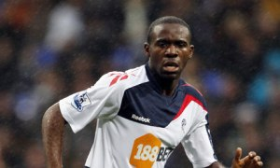
Who Remembers this? why?
Isaac Angulo : Peru – 1946
Marc Vivian Foe : Confederations Cup -Died 2003- 28 yrs
Fabrice Muamba: Bolton Wanderers *
John Kirkby : USA – 1956- 23 yrs
Dusan Ozbek: Galatasaray ,Turkey- 1997-17 yrs
Ivan Karcic: Bosnia -2007 -19yrs
Phil O’Donnell: Scotland- 2007 – 35 yrs
Kevon Carter: Trinidad and Tobago -2014-30yrs
Joel Lobanzo: Belguim- 2017-17yrs

Slide 4
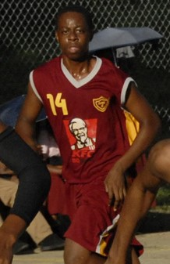
. .....Athletes Lives Matter
What if you could do something about this?
Dominic James;
High school footballer who died during a Manning Cup match due to heart failure in Sept. 2016
Saymar Ramsey; High school student athlete died Nov. 2016, after partaking in a sporting activity.
Member of the Spot Valley High basketball team, played in the ISSA/Western Conference Under-19 game, in Montego Bay.

Slide 5
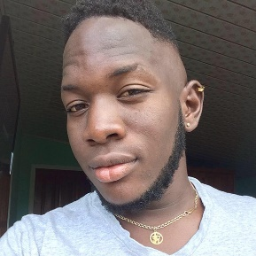
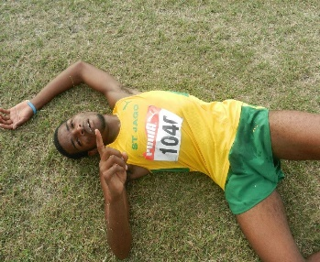
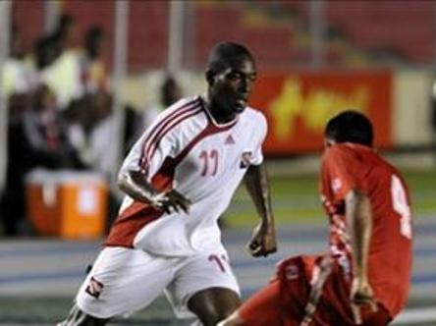
. .....Athletes Lives Matter
A wake up call is what this sudden death of Andrew “Eman” Andrews was labelled as by Anthony Moore, president of the Tobago Football Association (TFA), yesterday.
According to reports, Andrews, 22, a central defender with the Earlbrokes football team, collapsed 25 minutes into a match against Bethel United, just after 6 pm on Sunday at Riverbanks Oval, Mt St George, Tobago.
Jamaican Cavahn McKenzie died from a heart attack at Saturday’s North America, Central America and Caribbean (NACAC) Cross Country Championships, at the Mt Irvine Bay Golf Course, in Tobago.
PORT-OF-SPAIN, Trinidad (CMC) -- Trinidad and Tobago sports Minister Anil Roberts says he is shocked at the passing of former national footballer Kevon Carter.
Carter, 30, also a footballer with the country’s Defence Force, died on Friday after suffering a massive heart attack while at training with his club and never recovered.
“Kevon was a strong young man who gave 10 years dedicated service to the national team from U23 to senior level, playing most recently in the 2013 CONCACAF Gold Cup,” said Roberts.

Slide 6
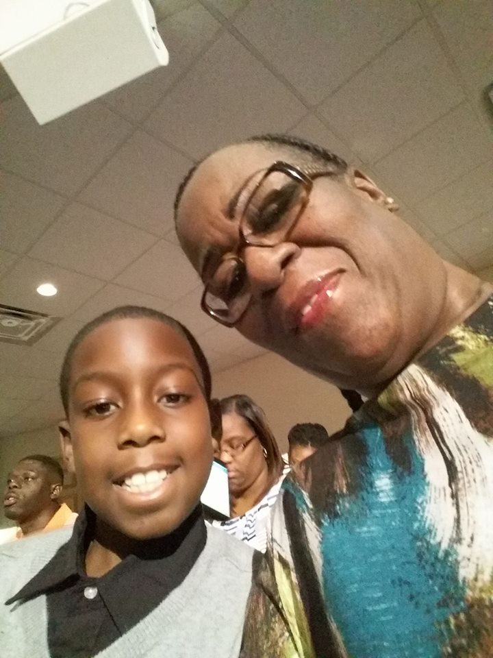
. .....Athletes Lives Matter
Boy dies after collapsing prior to track practice at Miami school
NORTHWEST MIAMI-DADE, FLA. (WSVN) An 11-year-old has died after, officials said, he collapsed before beginning track practice at a Miami school, March 1, 2017.
Kalib Harris (2006 – 2017)

Slide 7
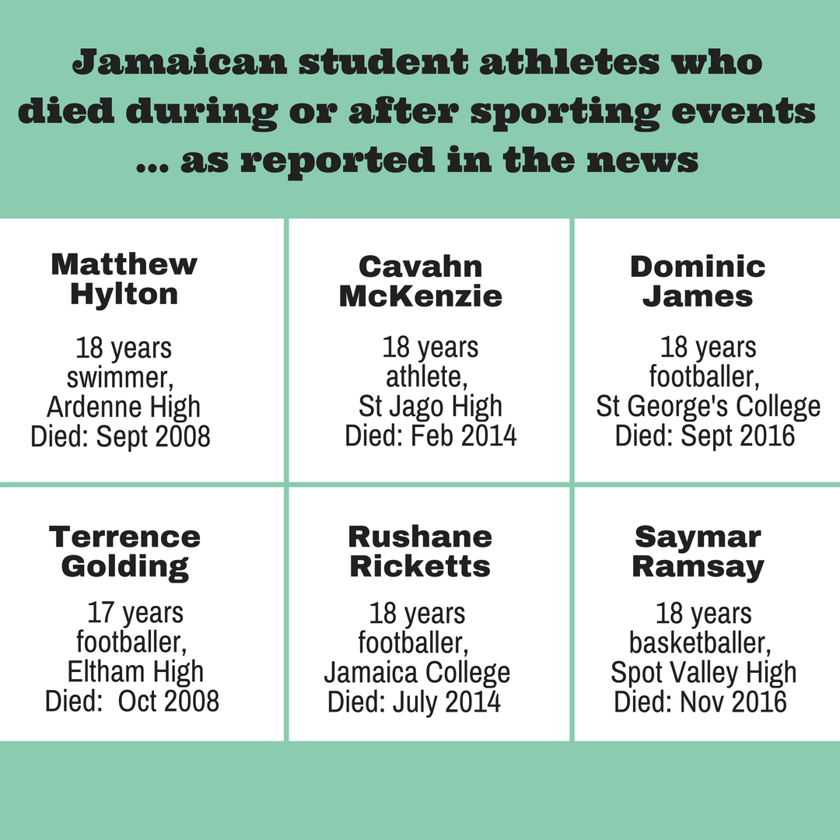
. .....Athletes Lives Matter
Posted on November 8, 2016 by diGJamaica

Slide 8
. .....Athletes Lives Matter
“Most of these guys and women, mostly guys, are dying of very well-known causes,” says Eric Larose, a cardiologist at the Quebec Heart and Lung Institute and a Heart and Stroke Foundation spokesperson. Many of these deaths could have be prevented if, beforehand, the victims knew their risk factors and the warning signs of an impending cardiac event.

Slide 9
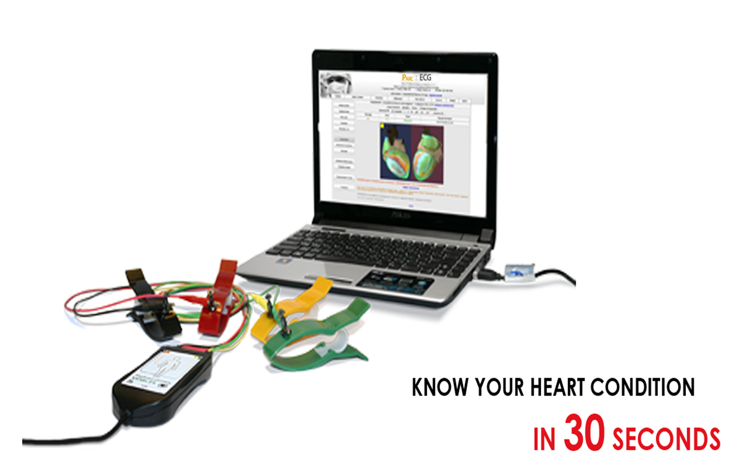
. .....Athletes Lives Matter
BE Heart Smart
PARC cardio screening Device Components

Slide 10
What is the PARC cardio screening device?
. .....Athletes Lives Matter
The PARC Cardio Screening Device is a new revolutionizing non-invasive screening tool used for assessing Cardio Fitness.
In a simple and convenient manner requiring only two minutes and no technical training.

Slide 11
. .....Athletes Lives Matter
Method of Operation
Four electrodes or limb leads
Data acquisitioned in 30 seconds
An image of the heart is formed on screen together with quantitative and qualitative analysis of cardiac electrical activity.

Slide 12
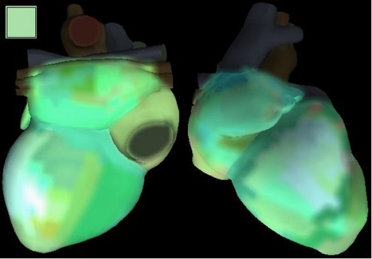
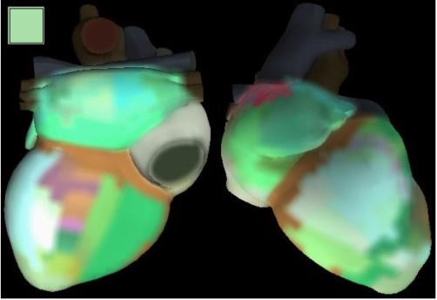
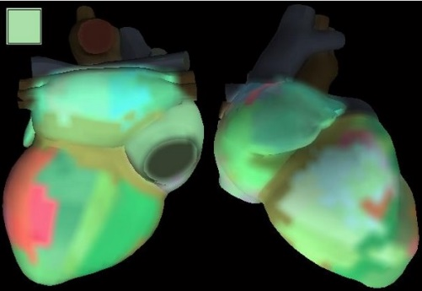
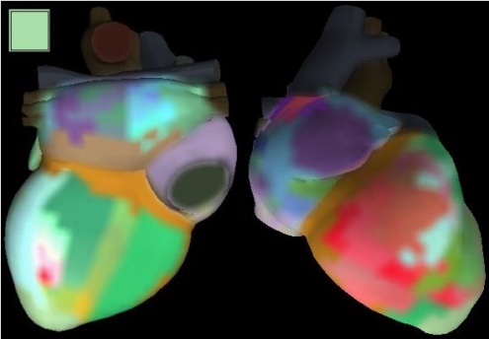
. .....Athletes Lives Matter
Parc Cardio Screening Device
The Parc Cardio Screening device creates a color-coded image of the heart in which green represents healthy and red represents pathological changes as observed in the maps below.

Slide 13
. .....Athletes Lives Matter
Parc Cardio Screening Device….continued
Analyzes low amplitude oscillations invisible to the human eye and is a highly sensitive indicator of pathological processes identifying areas where athletes are at high risk

Slide 14
Benefits
. .....Athletes Lives Matter
Athletes / Clients
Prevents death by sudden cardiac arrest due to early and regular cardio screening for pennies a day.
Personal Trainers / Coaches
Proper and complete assessment of clients cardio stress loads.
An extra tool tailoring to the clients fitness program.
An assessment tool to prevent over ambitious fitness goals.
Maintain competitive advantage.

Slide 15
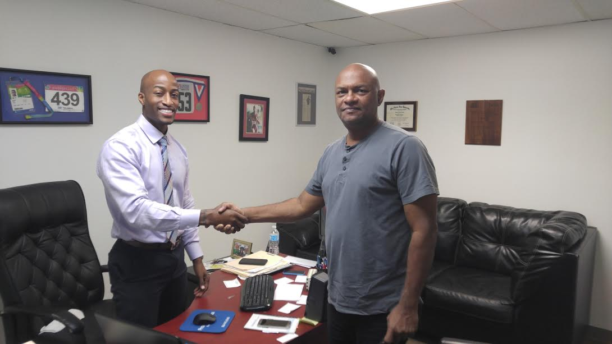
Jayson jones (2X Belizean Olympian)
. .....Athletes Lives Matter
Tests are currently being done on Olympians and the results have been astounding.
They have seen the necessity for the state of the art technology that is being offered by PARC Distributors.

Slide 16
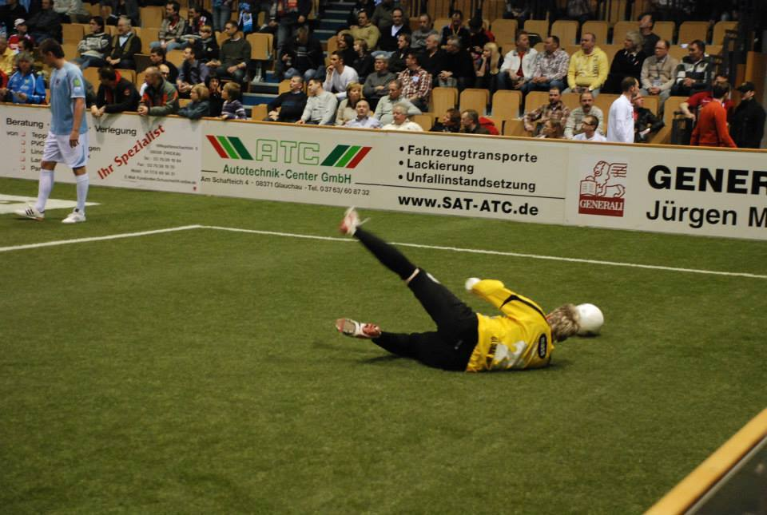
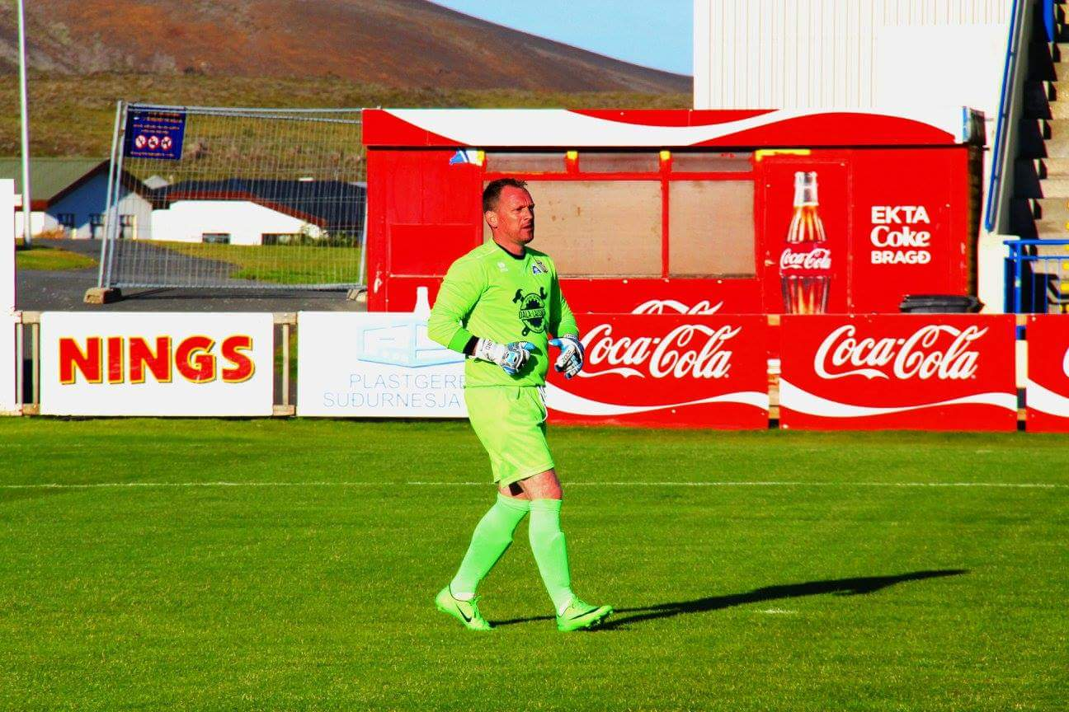
James Baird (Scottish Goalkeeper and athletic director)
. .....Athletes Lives Matter
To many Athletes and people are dying around the world , If I can help them be Heart-Smart and save a life in the process I think that’s my duty. Parc cardio screening is such an easy and amazing tool to flag up heart issues and should be a must for any coaches or fitness professionals.
BE Heart Smart!

Slide 17
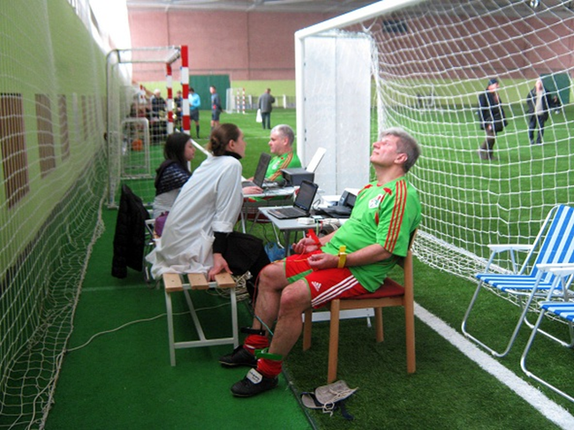
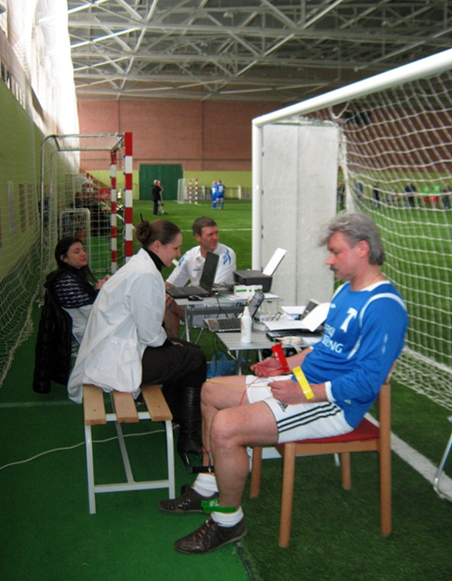
Application of PARC cardio screening devices by football teams and players. devices being used by both teams and individual players for assessments. Some players manage their heart rate variability for recovery and heavy training as well as current state under stress before matches as well. PT’s and coaches are now able manage the process in real time.
. .....Athletes Lives Matter

Slide 18
. .....Athletes Lives Matter
“Paving the way for new age technology that’s changing the Health and Fitness Industry as we know it!”
This Cardio Screening is not intended to replace the advice of a Physician or diagnose any illness or disease,
one should always consult one’s Physician.

Slide 19
. .....Athletes Lives Matter
Be the first in
your local area.
Create the change!
Email: parcdis@gmail.com
Phone: +1 (646) 470 7811
Website: www.parcwellnesscentres.com or www.parccardio.com

Slide 20
. .....Athletes Lives Matter
The End

Slide 21
RefErenceS
https://www.theguardian.com/science/2018/aug/08/more-young-footballers-dying-of-heart-problems-than-thought-fa-study-finds
https://www.theguardian.com/football/2014/feb/28/trinidad-and-tobago-kevon-carter-dies-heart-attack
http://www.socawarriors.net/minor-leagues/14115-footballer-dies-after-scoring.html
https://www.tv6tnt.com/news/7pmnews/footballer-dies/article_e380eff0-6dfe-50f4-bf3c-85ced610701d.html
https://www.facebook.com/961wefm/photos/club-sando-footballer-marcus-lawrence-who-collapsed-during-training-last-friday-/10152347974538681/
https://ipfs.io/ipfs/QmXoypizjW3WknFiJnKLwHCnL72vedxjQkDDP1mXWo6uco/wiki/List_of_association_footballers_who_died_while_playing.html
https://en.wikipedia.org/wiki/Akeem_Adams
https://wired868.com/2013/12/30/akeem-passes-away-warrior-dies-unassisted-in-budapest/
https://bbj.hu/budapest/akeem-adams-trinidad--and--tobago-native-ferencv%C3%A1ros-footballer-dies_73894
https://www.clinicaladvisor.com/features/sudden-death-in-young-athletes/article/697831/
http://bahamaspress.com/2014/02/24/mckenzie-died-from-heart-attack-two-bahamians-who-came-hot-last-were-also-in-that-race/
https://www.pressreader.com/jamaica/jamaica-gleaner/20170630/281517931137646

